Slide 1
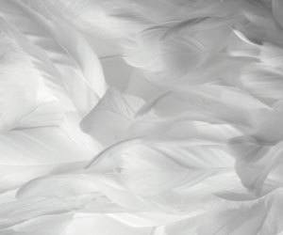
God’s Protection
Psalms 91:4-12
91:4 He shall cover thee with his feathers, and under his wings shalt thou trust; his truth shall be thy shield and buckler. 91:5 Thou shalt not be afraid for the terror by night; nor for the arrow that flieth by day;
91:6 Nor for the pestilence that walketh in darkness; nor for the destruction that wasteth at noonday.
91:7 A thousand shall fall at thy side, and ten thousand at thy right hand; but it shall not come nigh thee.
91:8 Only with thine eyes shalt thou behold and see the reward of the wicked.
91:9 Because thou hast made the Lord, which is my refuge, even the Most High, thy habitation;
91:10 There shall no evil befall thee, neither shall any plague come nigh thy dwelling.
91:11 For he shall give his angels charge over thee, to keep thee in all thy ways.
91:12 They shall bear thee up in their hands, lest thou dash thy foot against a stone.

Slide 2
What is protection?
Any measure taken to guard a thing against damage caused by outside forces.
A person or thing that prevents someone or something from suffering harm or injury
Synonyms:
Defense, shielding, shelter, preservation, safety, sanctuary, refuge, barrier, shield, hedge, armor, safeguard.

Slide 3
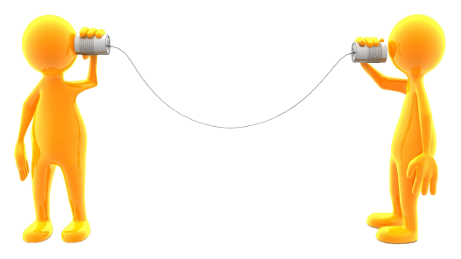
What does it take to Protect?
Communication
Rules

Slide 4
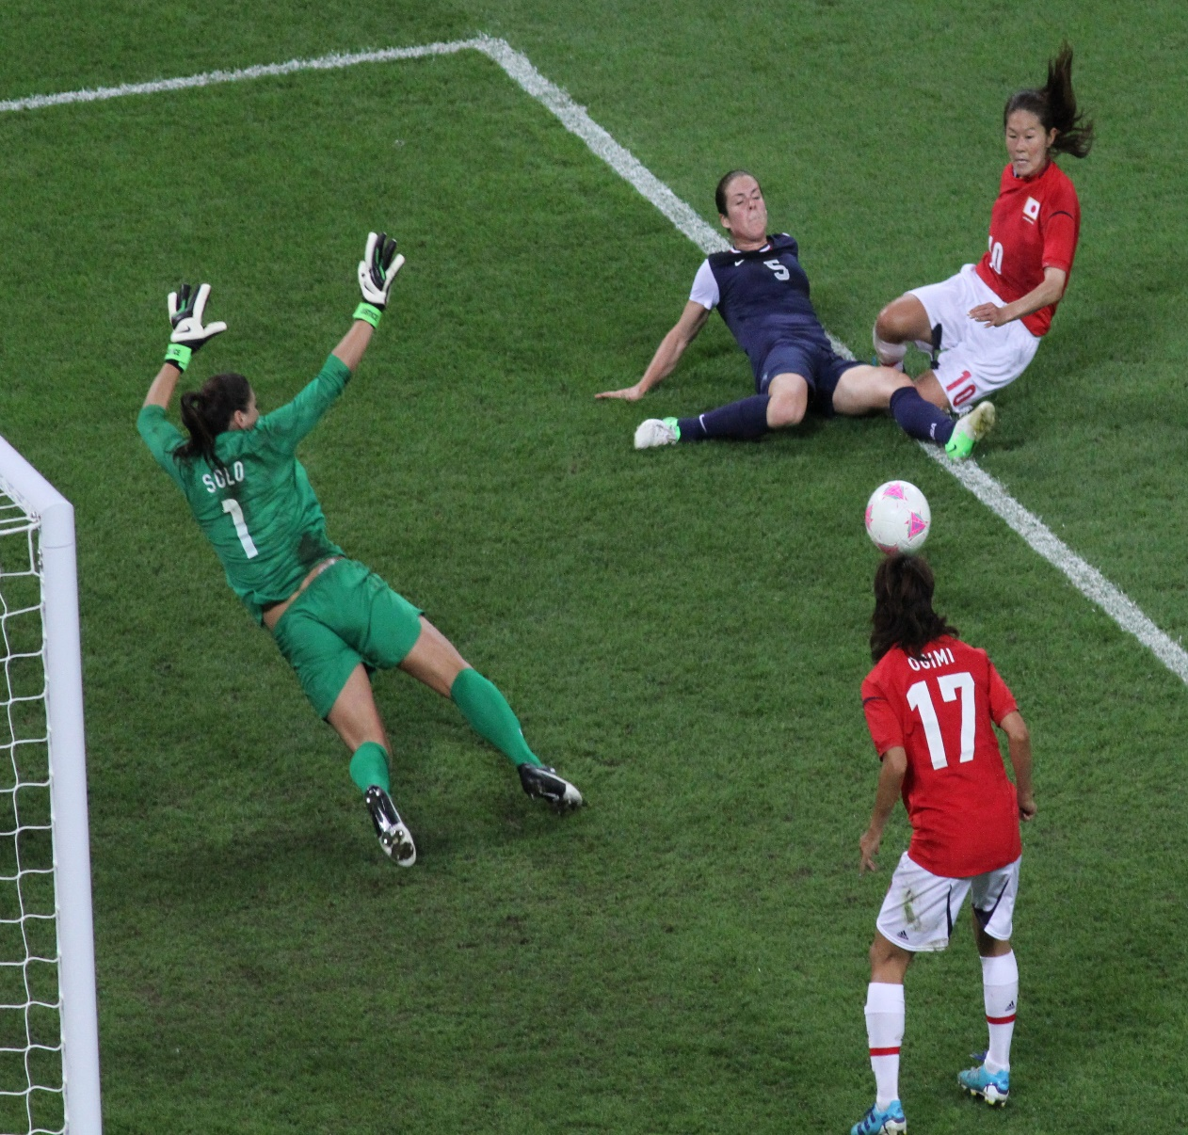
Goal=Spiritual being/our Temples Ball=Satan/Bad things in our lives

Slide 5
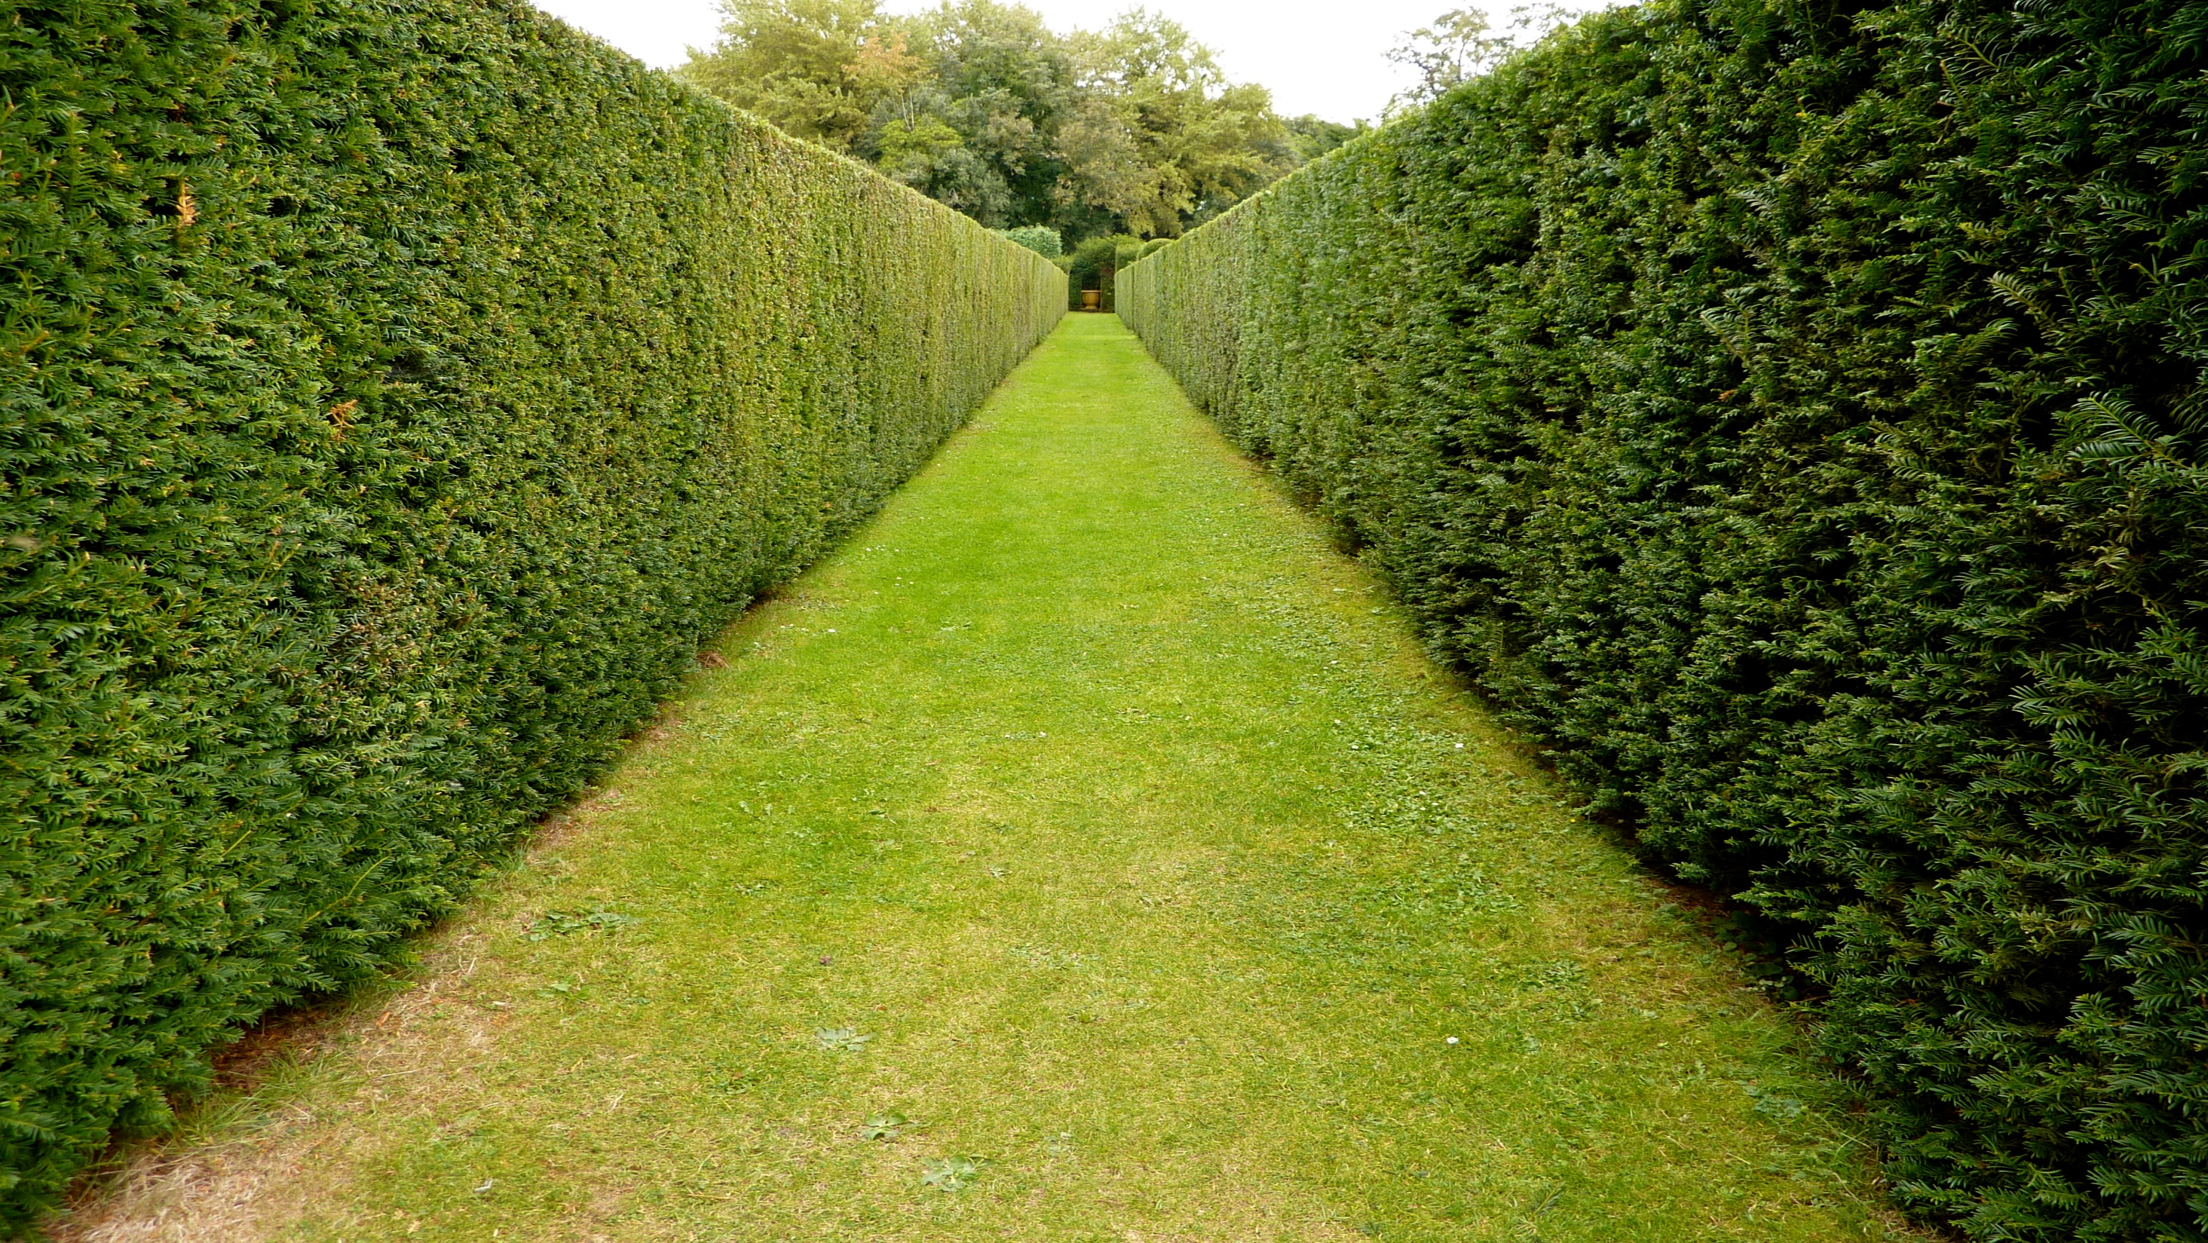
Job 1:9-12
9 Then Satan answered the Lord, and said, Doth Job fear God for naught?
10 Hast not thou made a hedge about him, and about his house, and about all that he hath on every side? thou hast blessed the work of his hands, and his substance is increased in the land.
11 But put forth thine hand now, and touch all that he hath, and he will curse thee to thy face.
12 And the Lord said unto Satan, Behold, all that he hath is in thy power; only upon himself put not forth thine hand. So Satan went forth from the presence of the Lord.

Slide 6
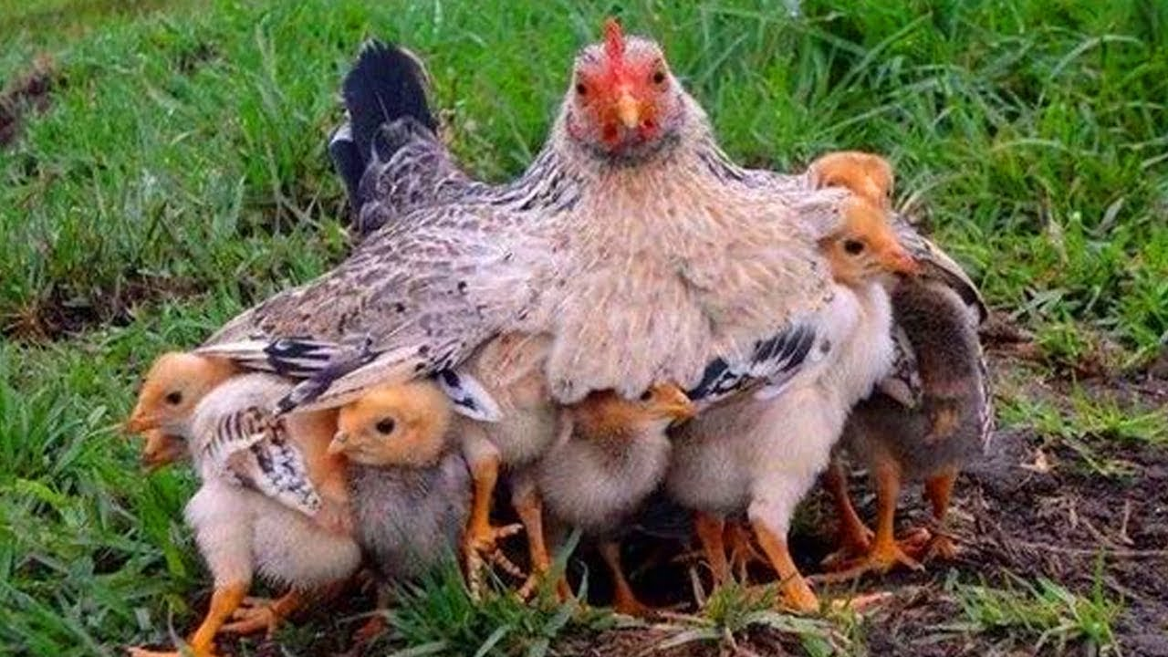
Matthew 23:37; Luke 13:35; D&C 3:15e; D&C 28:1a; D&C 43:6b
III Nephi 4:55-58
55) And it came to pass that there came a voice again unto the people, and all the people did hear, and did witness of it saying, O ye people of these great cities which have fallen, who are descendants of Jacob; yea, who are of the house of Israel, O, ye people of the house of Israel, how oft have I gathered you as a hen gathereth her chickens under her wings, and have nourished you.
56) And again, how oft would I have gathered you, as a hen gathereth her chickens under her wings; yea, O ye people of the house of Israel, who have fallen;
57) Yea, O ye people of the house of Israel; ye that dwell at Jerusalem, as ye that have fallen; yea, how oft would I have gathered you as a hen gathereth her chickens, and ye would not.
58) O ye house of Israel, whom I have spared, how oft will I gather you as a hen gathereth her chickens under her wings, if ye will repent and return unto me with full purpose of heart

Slide 7
Physical Protection
Jacob 1:10 Mosiah 6:18 Alma 1:88
Alma 12:30-35, 43-49, 161 Alma 14:60
Alma 15:24 Helaman 5:111 4th Nephi 1:33-35
Jaradities crossing the waters
Nephi bound on the ship-People disobeyed, Liahona didn’t work
David facing Goliath
Daniel in the Lions den
Sampson-Obedient, protected; Disobeyed, hedge lowered

Slide 8
Spiritual Protection
Pray
1 Thessalonians 5:17-18
17 Pray without ceasing.
18 In everything give thanks; for this is the will of God in Christ Jesus concerning you.
Mosiah 11:149
And they did admonish their brethren; and they were also admonished, every one, by the word of God, according to his sins, or to the sins which he had committed; being commanded of God to pray without ceasing, and to give thanks in all things.

Slide 9
Spiritual Protection
Fast
Isaiah 58:6
Is not this the fast that I have chosen? to loose the bands of wickedness, to undo the heavy burdens, and to let the oppressed go free, and that ye break every yoke?
Alma 4:6
Nevertheless the children of God were commanded that they should gather themselves together oft, and join in fasting and mighty prayer, in behalf of the welfare of the souls of those who knew not God
Alma 12:4-5
4 For they were men of a sound understanding, and they had searched the scriptures diligently, that they might know the word of God. 5 But this is not all: they had given themselves to much prayer, and fasting, therefore they had the spirit of prophecy, and the spirit of revelation, and when they taught, they taught with power and authority, even as with the power and authority of God.

Slide 10
Spiritual Protection
Cleansing Life
Psalms 19:12
Who can understand his errors? cleanse thou me from secret faults.
1 John 1:7-9
7 But if we walk in the light, as he is in the light, we have fellowship one with another, and the blood of Jesus Christ his Son cleanseth us from all sin. 8 If we say that we have no sin, we deceive ourselves, and the truth is not in us. 9 If we confess our sins, he is faithful and just to forgive us our sins, and to cleanse us from all unrighteousness.

Slide 11
Spiritual Protection
Reading/Studying
Reading involves going through a particular topic to gather information from it.
Studying requires more devotion, time and energy when compared to reading.
Studying involves researching and learning while reading involves perusing through texts to understand concepts.

Slide 12
Spiritual Protection
Total and Complete Submission
James 4:7-8
7 Submit yourselves therefore to God. Resist the devil, and he will flee from you. 8 Draw nigh to God, and he will draw nigh to you. Cleanse your hands, ye sinners; and purify your hearts, ye double-minded.
Mosiah 1:119-120
119 For the natural man is an enemy to God, and has been, from the fall of Adam, and will be, for ever and ever; 120 But if he yields to the enticings of the Holy Spirit, and putteth off the natural man, and becometh a saint, through the atonement of Christ, the Lord, and becometh as a child, submissive, meek, humble, patient, full of love, willing to submit to all things which the Lord seeth fit to inflict upon him, even as a child doth submit to his father.

Slide 13
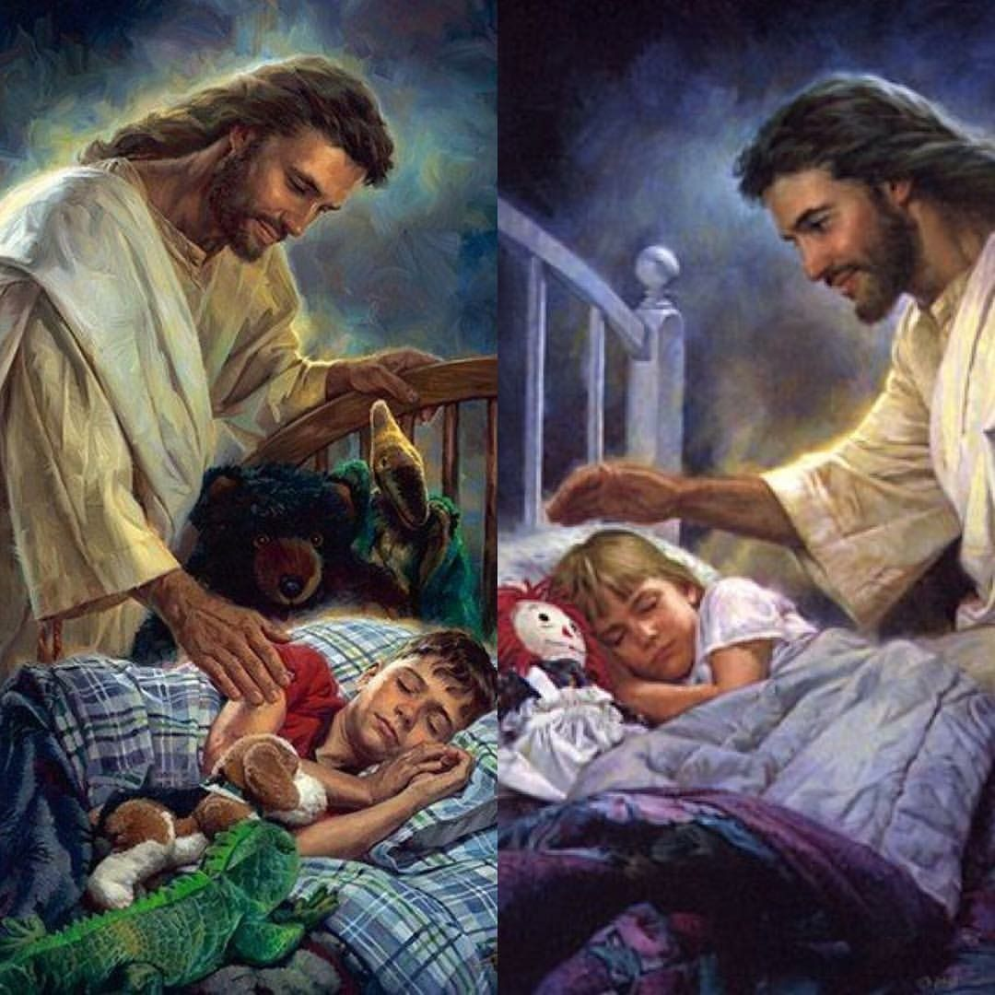
EVERYDAY God protects us. We need to give Him thanks every time, even in the small unknown ways.

Slide 14
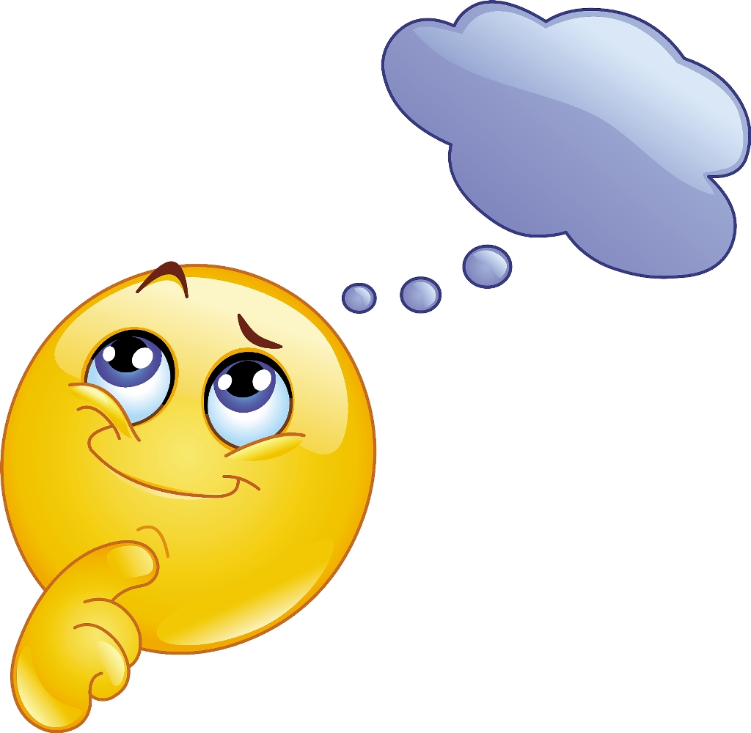
When has God protected you?
How has God protected you?
Do you thank him?

